Slide 1
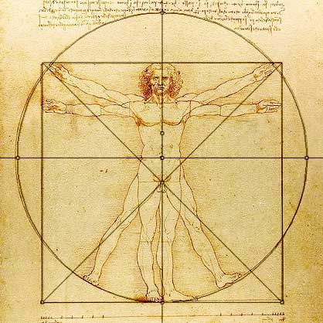
The Vitruvian man
http://blog.world-mysteries.com/science/vitruvian-man-by-leonardo-da-vinci/
http://blog.world-mysteries.com/science/vitruvian-man-by-leonardo-da-vinci/

Slide 2
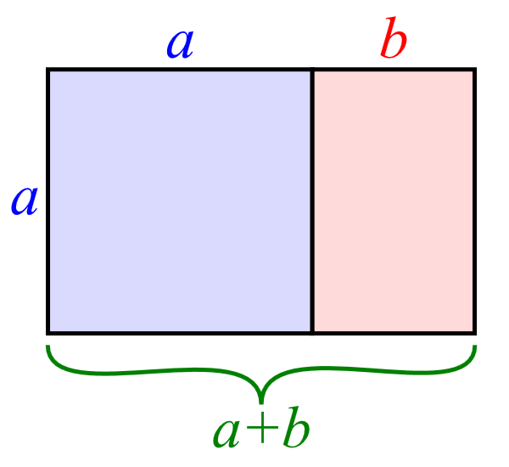
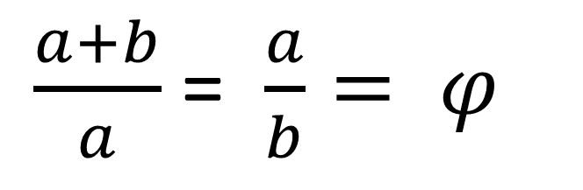
Golden rectangle
$\frac{a+b}{a}$ = $\frac{a}{b}= φ$
By Ahecht (Original); Pbroks13 (Derivative work); Joo. (Editing) - Own work, Public Domain, https://commons.wikimedia.org/w/index.php?curid=15656641

Slide 3
The Vitruvian man
NOT IN GOLDEN RATIO
http://blog.world-mysteries.com/science/vitruvian-man-by-leonardo-da-vinci/
http://blog.world-mysteries.com/science/vitruvian-man-by-leonardo-da-vinci/

Slide 4

The Sacrament of Last Supper by Salvador Dali
IN GOLDEN RATIO
By National Gallery of Art, Washington D.C., Fair use, https://en.wikipedia.org/w/index.php?curid=24679655

Slide 5
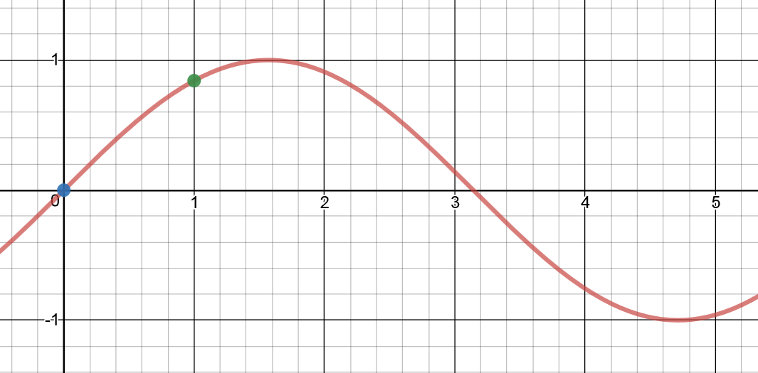
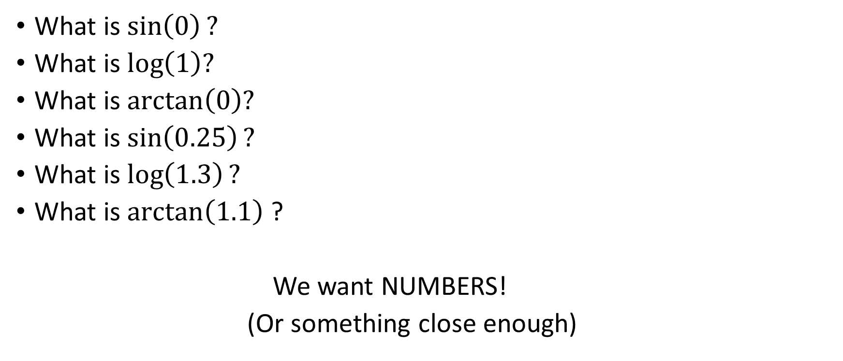
Approximations
What is $\sin\left(0\right)?$
What is $\log\left(1\right)?$
What is $\arctan\left(0\right)?$
What is $\sin\left(0.25\right)?$
What is $\log\left(1.3\right)?$
What is $\arctan\left(1.1\right)$?
We want NUMBERS!
(Or something close enough)
Graphed using desmos.com

Slide 6
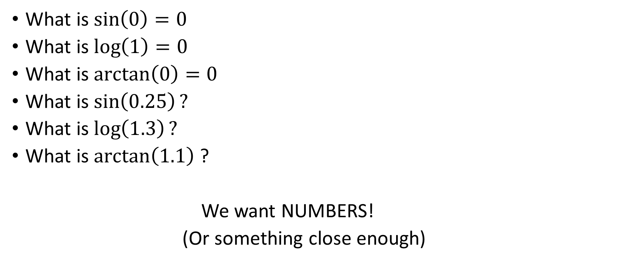
Approximations
What is $\sin\left(0\right)=0$
What is $\log\left(1\right)=0$
What is $\arctan\left(0\right)=0$
What is $\sin\left(0.25\right)?$
What is $\log\left(1.3\right)?$
What is $\arctan\left(1.1\right)$?
We want NUMBERS!
(Or something close enough)

Slide 7
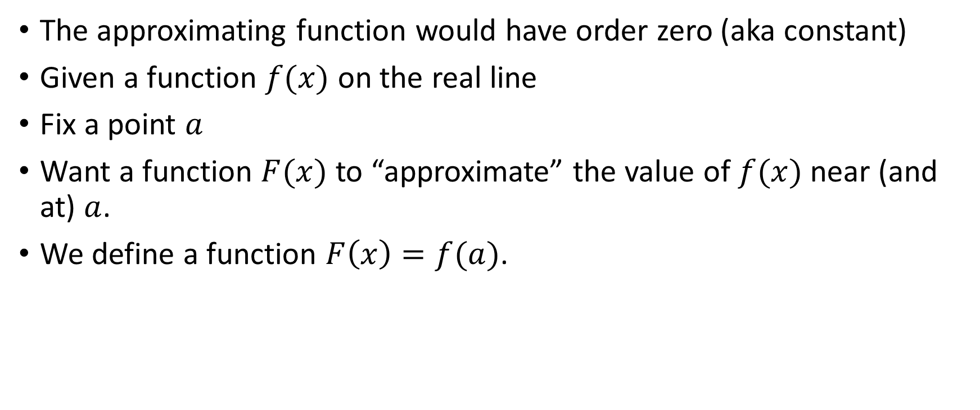
Zeroeth Order Approximation
The approximating function would have order zero (aka constant)
Given a function $f(x)$ on the real line
Fix a point $a$
Want a function $F(x)$ to “approximate” the value of $f(x)$ near (and at) $a$.
We define a function $F\left(x\right)=f(a)$.

Slide 8
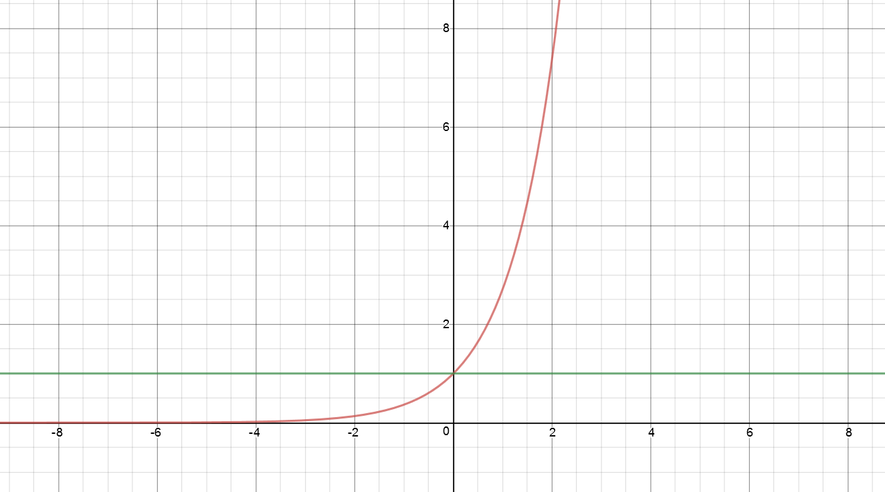
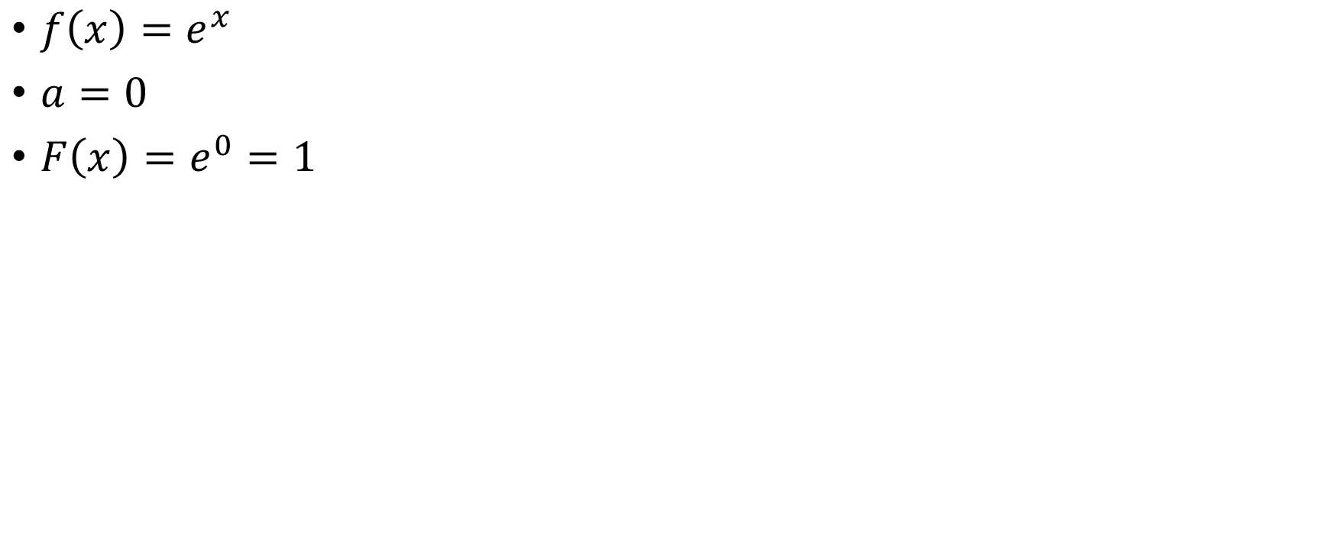
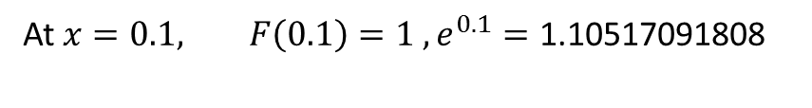
Example 1
$f\left(x\right)=e^{x}$
$a=0$
$F\left(x\right)=e^{0}=1$
Graphed using desmos.com
At $x=0.1, F\left(0.1\right)=1 , e^{0.1}=\text{1.10517091808}$

Slide 9
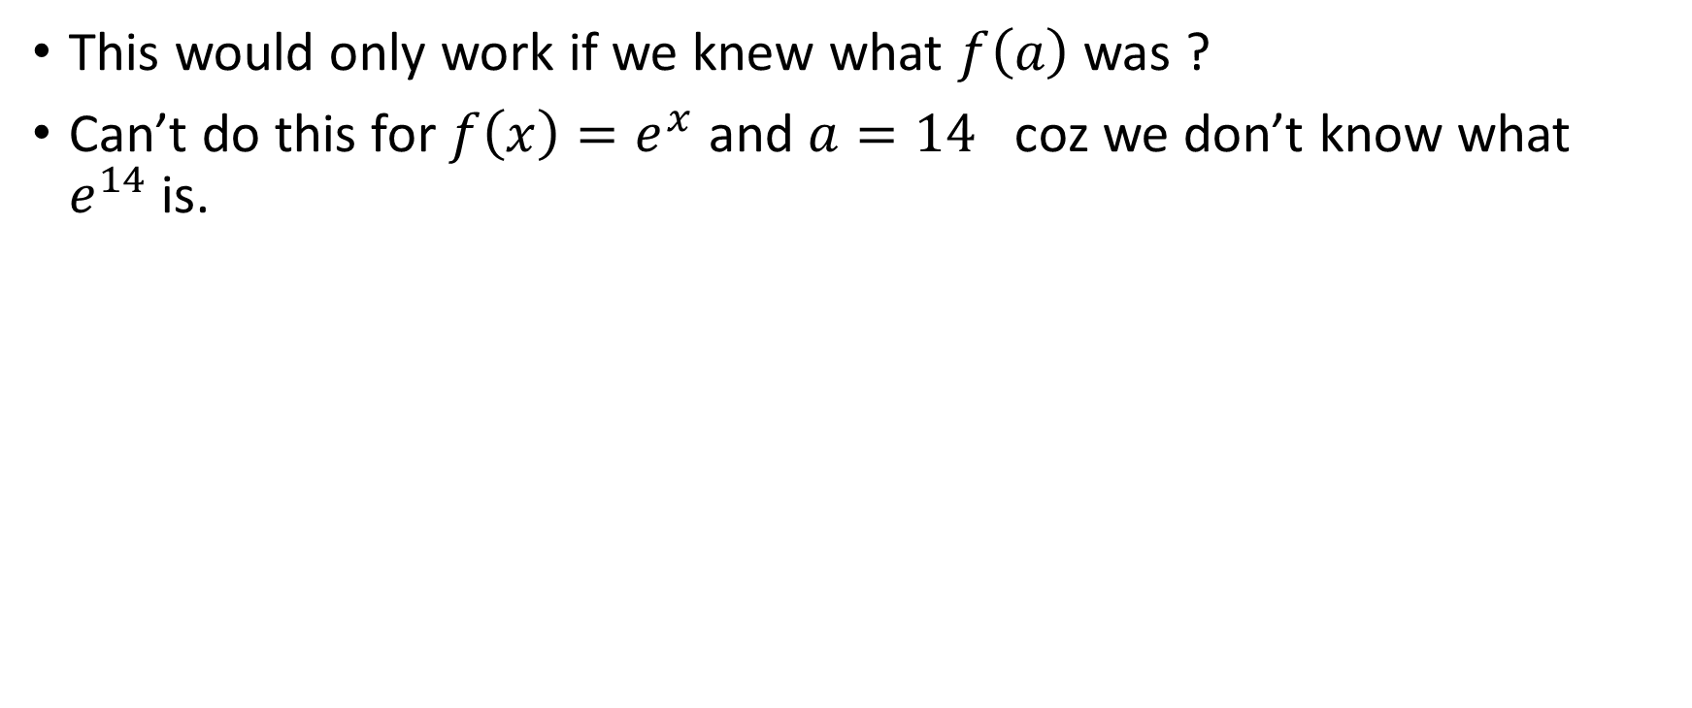
Remark
This would only work if we knew what $f\left(a\right)$ was ?
Can’t do this for $f\left(x\right)=e^{x}$ and $a=14$ coz we don’t know what $e^{14}$is.

Slide 10
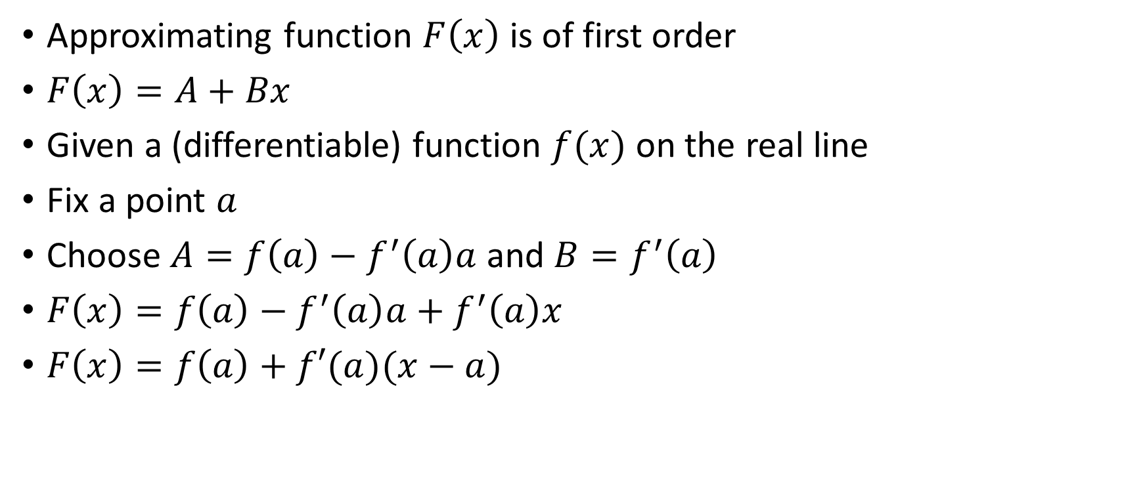
First order approximation
Approximating function $F\left(x\right)$ is of first order
$F\left(x\right)=A+Bx$
Given a (differentiable) function $f(x)$ on the real line
Fix a point $a$
Choose $A=f\left(a\right)−f^{′}\left(a\right)a$ and $B=f^{′}\left(a\right)$
$F\left(x\right)=f\left(a\right)−f^{′}\left(a\right)a+f^{′}\left(a\right)x$
$F\left(x\right)=f\left(a\right)+f′(a)(x−a)$

Slide 11
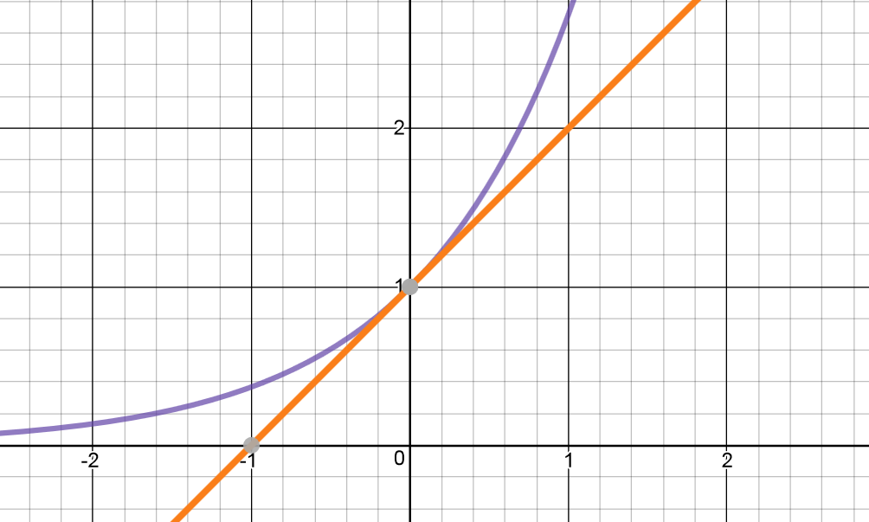
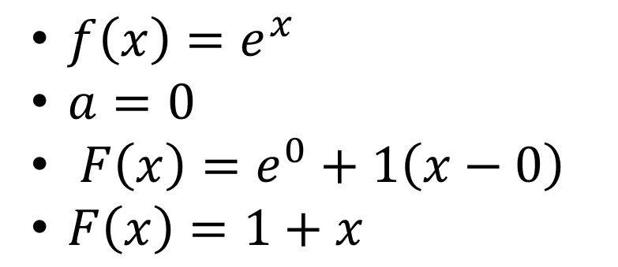

Example 2
$f\left(x\right)=e^{x}$
$a=0$
$F\left(x\right)=e^{0}+1\left(x−0\right)$
$F\left(x\right)=1+x$
At $x=0.1, F\left(0.1\right)=1.1$
$$e^{0.1}=\text{1.10517091808}$$

Slide 12
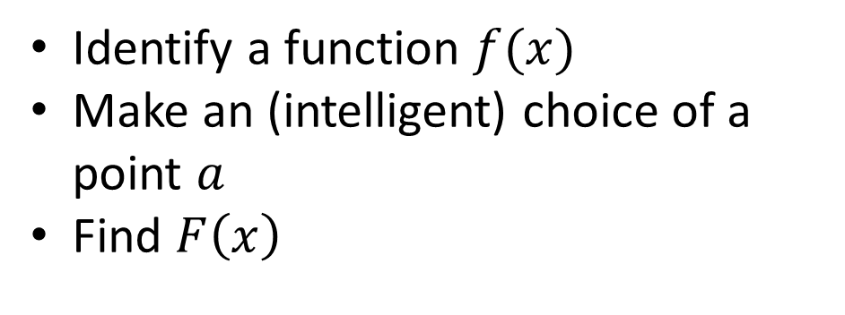
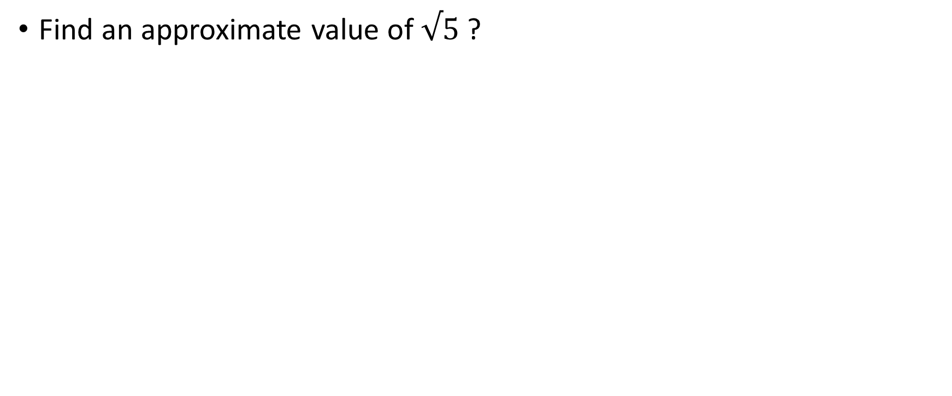
Example 3
Find an approximate value of $√5$ ?
Identify a function $f(x)$
Make an (intelligent) choice of a point $a$
Find $F\left(x\right)$

Slide 13


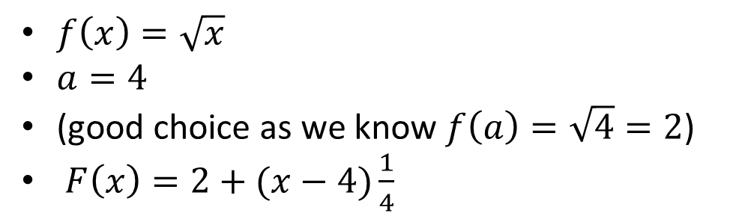
Example 3
Find an approximate value of $√5$ ?
Identify a function $f(x)$
Make an (intelligent) choice of a point $a$
Find $F\left(x\right)$
$f\left(x\right)=\sqrt{x}$
$a=4$
(good choice as we know $f\left(a\right)=\sqrt{4}=2$)
$F\left(x\right)=2+(x−4)\frac{1}{4}$
$$F\left(5\right)=2+\frac{\left(5−4\right)}{4}=2+0.25=2.25$$
$$\sqrt{5}=2.236$$

Slide 14
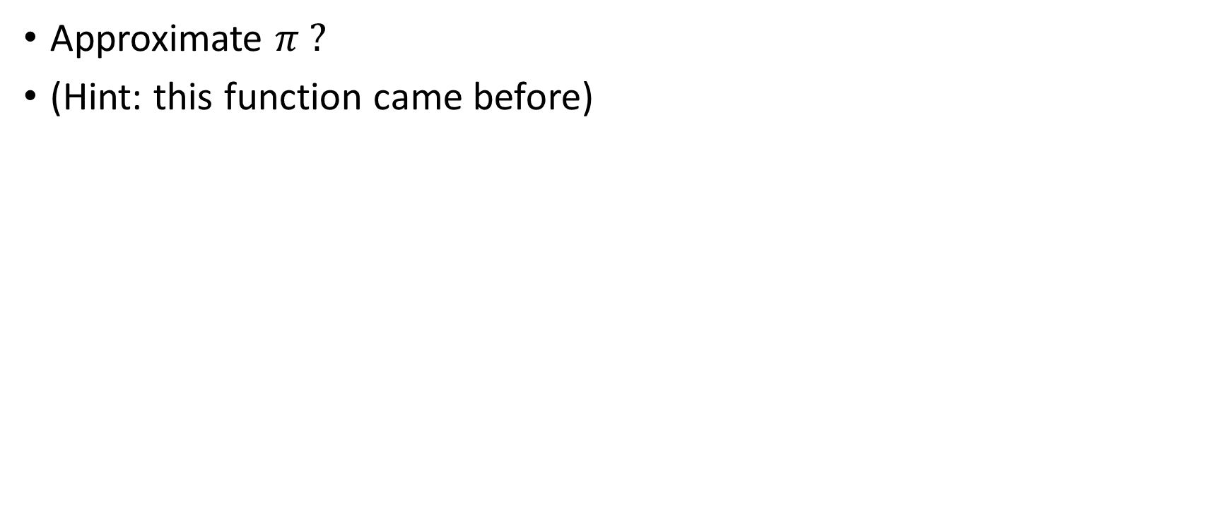
Example 4
Approximate $π ?$
(Hint: this function came before)

Slide 15
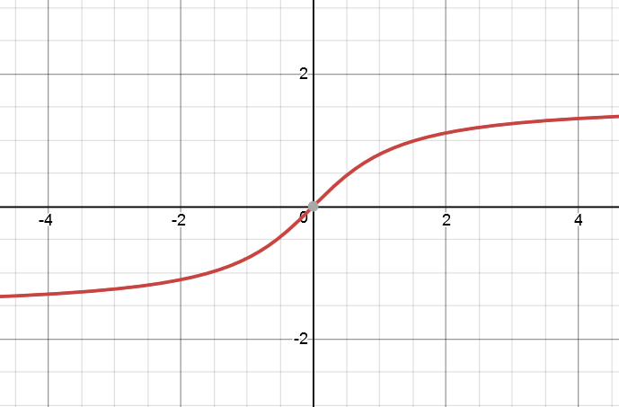
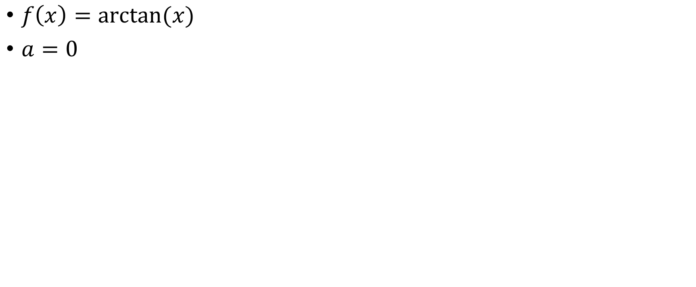
$f\left(x\right)=\arctan{(x)}$
$a=0$

Slide 16
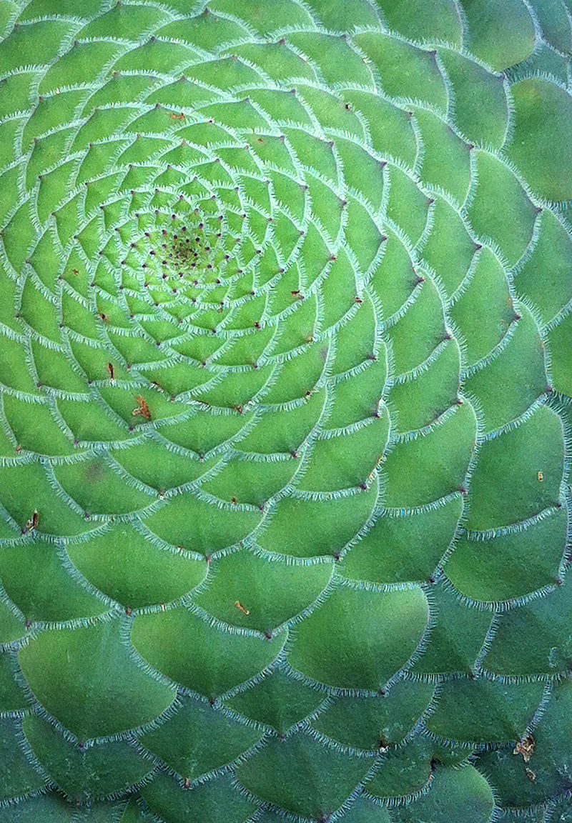
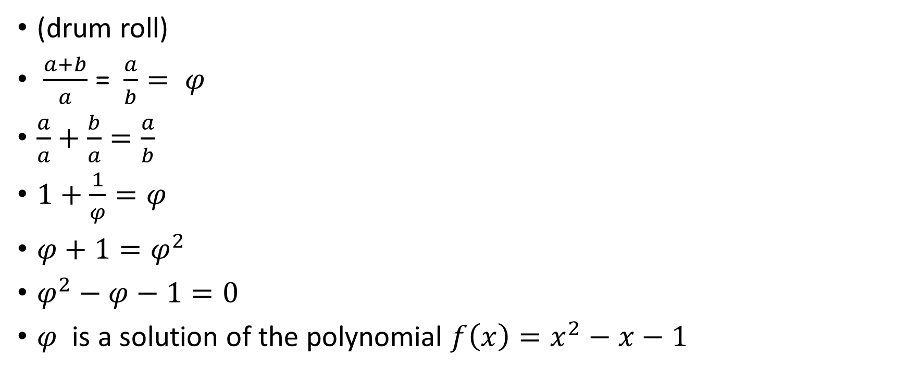
Finding the Golden ratio!
(drum roll)
$\frac{a+b}{a}$ = $\frac{a}{b}= φ$
$\frac{a}{a}+\frac{b}{a}=\frac{a}{b}$
$1+\frac{1}{φ}=φ$
$φ+1=φ^{2}$
$φ^{2}−φ−1=0$
$φ$ is a solution of the polynomial $f\left(x\right)=x^{2}−x−1$
By Max Ronnersjö - Own work, CC BY-SA 3.0, https://commons.wikimedia.org/w/index.php?curid=19108050

Slide 17
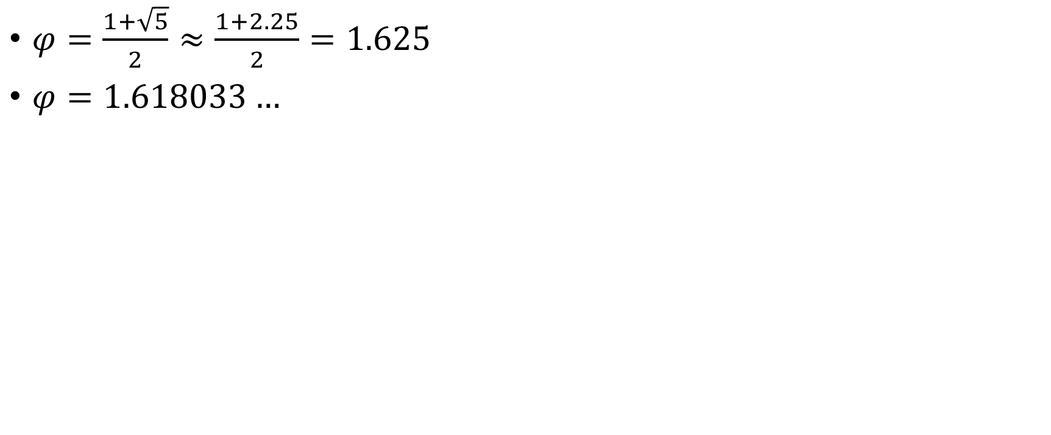
$φ=\frac{1+\sqrt{5}}{2}≈\frac{1+2.25}{2}=1.625$
$φ=1.618033…$

Slide 18
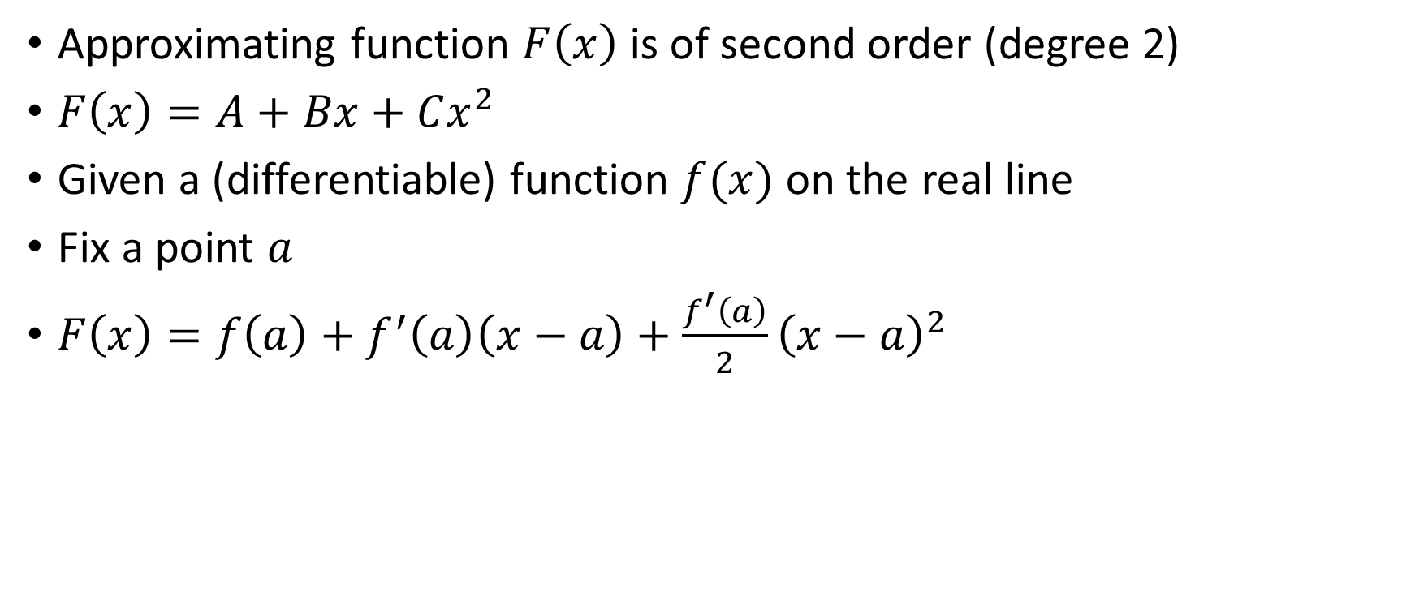
Second order approximation
Approximating function $F\left(x\right)$ is of second order (degree 2)
$F\left(x\right)=A+Bx+Cx^{2}$
Given a (differentiable) function $f(x)$ on the real line
Fix a point $a$
$F\left(x\right)=f\left(a\right)+f^{′}\left(a\right)\left(x−a\right)+\frac{f^{′}\left(a\right)}{2}{\left(x−a\right)}^{2}$

Slide 19
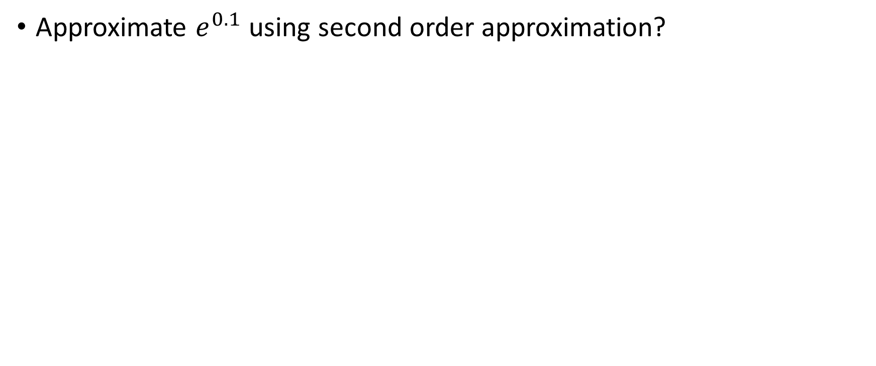
Example 5
Approximate $e^{0.1}$ using second order approximation?

Slide 20
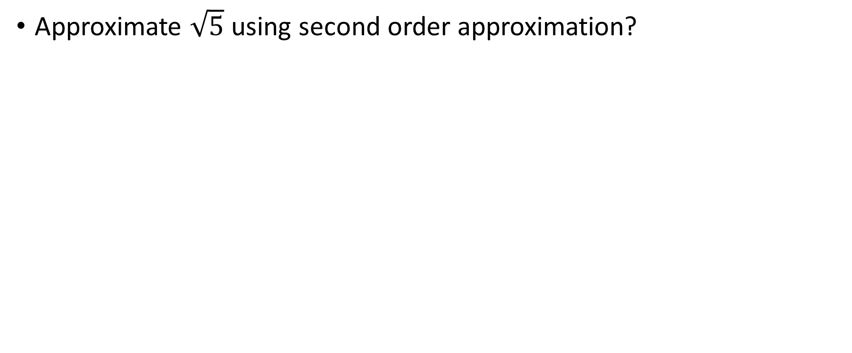
Example 6
Approximate $\sqrt{5}$ using second order approximation?

Slide 21
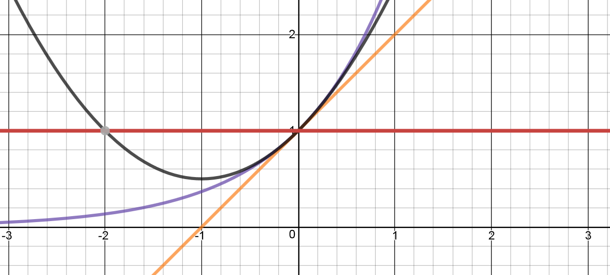
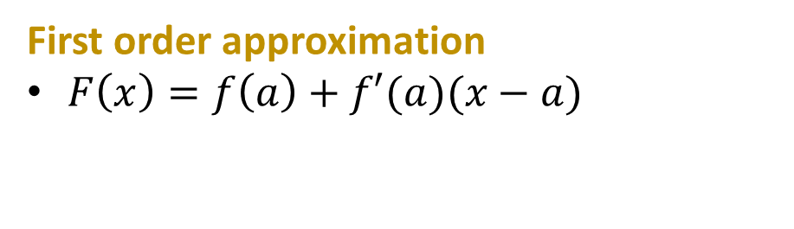
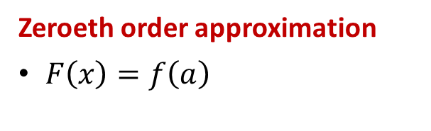

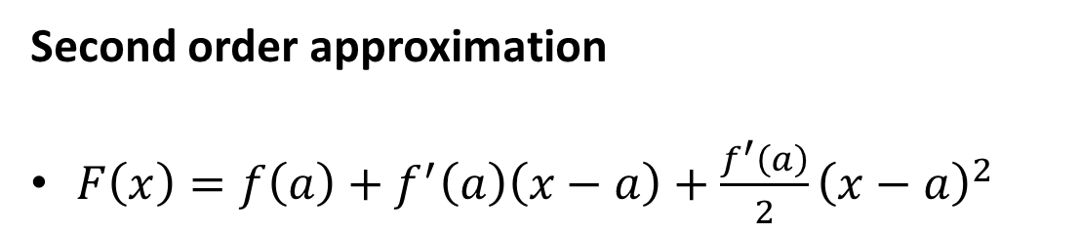
To sum it all up
$$f\left(x\right)=e^{x}$$
Zeroeth order approximation
$F\left(x\right)=f\left(a\right)$
First order approximation
$F\left(x\right)=f\left(a\right)+f′(a)(x−a)$
Second order approximation
$F\left(x\right)=f\left(a\right)+f^{′}\left(a\right)\left(x−a\right)+\frac{f^{′}\left(a\right)}{2}{\left(x−a\right)}^{2}$

Slide 22
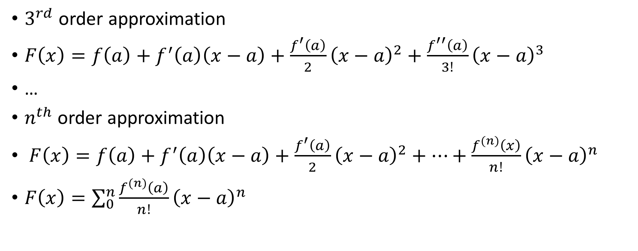
Higher order approximation aka
Taylor polynomials
$3^{rd}$ order approximation
$F\left(x\right)=f\left(a\right)+f^{′}\left(a\right)\left(x−a\right)+\frac{f^{′}\left(a\right)}{2}{\left(x−a\right)}^{2}+\frac{f^{′′}\left(a\right)}{3!}{\left(x−a\right)}^{3}$
…
$n^{th}$ order approximation
$F\left(x\right)=f\left(a\right)+f^{′}\left(a\right)\left(x−a\right)+\frac{f^{′}\left(a\right)}{2}{\left(x−a\right)}^{2}+…+\frac{f^{(n)}\left(x\right)}{n!}{\left(x−a\right)}^{n}$
$F\left(x\right)=\sum_{0}^{n}{\frac{f^{(n)}\left(a\right)}{n!}{\left(x−a\right)}^{n}}$

Slide 23
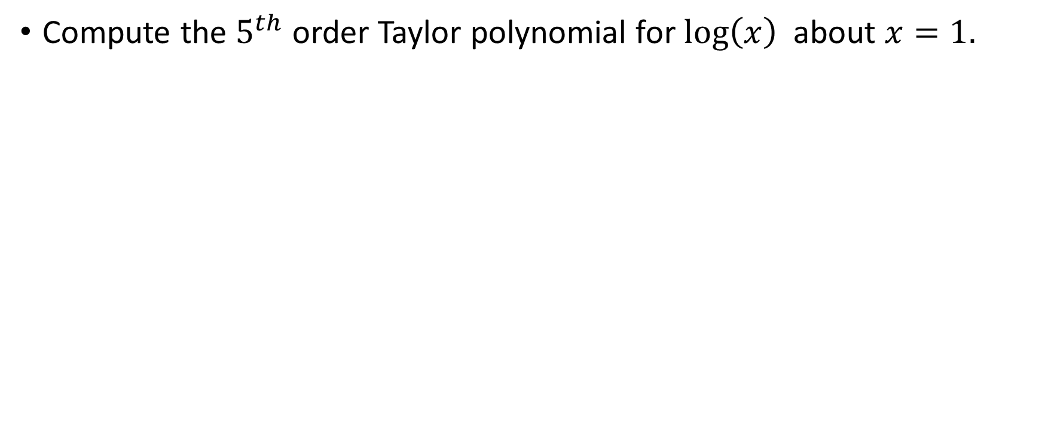
Compute the $5^{th}$ order Taylor polynomial for $\log\left(x\right)$ about $x=1.$

Slide 24
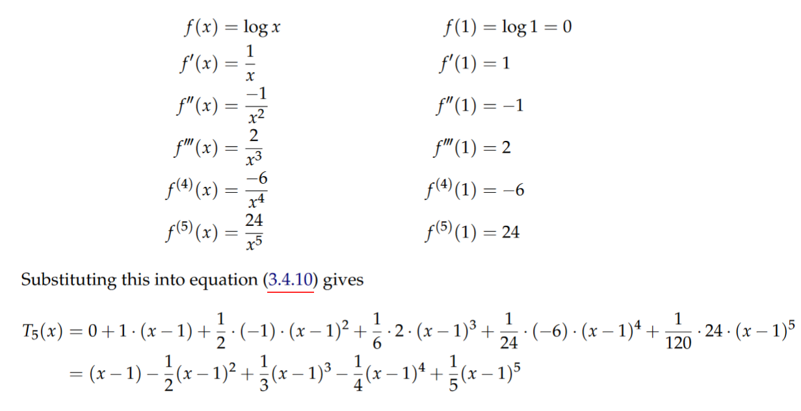

Compute the $5^{th}$ order Taylor polynomial for $\log\left(x\right)$ about $x=1.$
And the final slide!

Slide 25
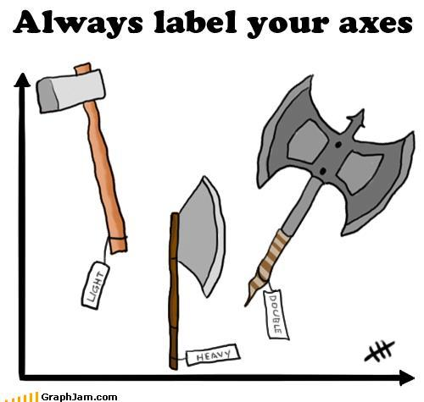
https://www.cazoommaths.com/maths-jokes/

